Slide 1
Team Ownership Map
Roles → Deliverables → Cross-review
Mehmet ALGÜL
Yasin YILDIRIM
Role: System Software & ConOps Integration
Role: AI-Focused Software Design & Architecture
Key Deliverables: ConOps alignment across modes; TTS/STT workflow; I/O logic (commands, alerts, state transitions); safe-mode behaviors and UX message set
Key Deliverables: Vision pipeline design; image processing + pre/post-processing plan; model trade-off analysis (YOLO vs U-Net) and optimization direction; latency/FPS targets & constraints mapping to FR/NFR
Interfaces: Connects perception + navigation outputs into user-facing guidance; defines decision thresholds and fallback messaging
Interfaces: Defines model I/O contract (detections → obstacle classes/confidence) consumed by ConOps + alert logic
İlayda YAKAR
Enes ÜNLÜ
Role: System Integration, Reliability & Robustness
Role: Embedded Hardware & Offline Navigation
Key Deliverables: Power modes & thermal-aware operation; sensor health checks/watchdog strategy; physical robustness considerations (connectors, sealing, wearability); fail-safe triggers (stop & rescan)
Key Deliverables: Hardware integration plan (compute + sensors); offline OSM region strategy; routing + reroute logic; localization drift handling assumptions (GPS noise / urban canyon)
Interfaces: Ensures modules work end-to-end under real conditions; ties power/thermal limits to dynamic scaling behavior
Interfaces: Provides navigation outputs (turn-by-turn / reroute signals) to interaction layer; aligns map update workflow with offline constraints

Slide 2
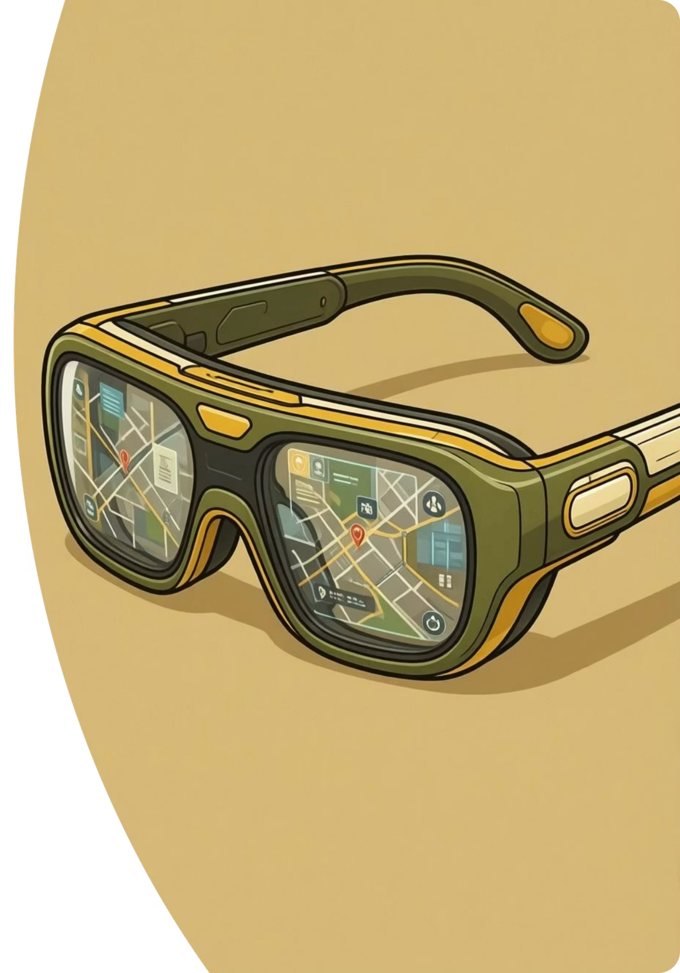
ALAS
AI-Based Smart Glasses
for Visually Impaired
Outdoor Navigation
An offline, edge-AI based smart glasses system providing real-time environmental perception and pedestrian navigation.
Graduation Project – Ankara Science University
Advisor: Assoc. Prof. Dr. M. Nedim Alpdemir

Slide 3






Why This Project Matters
Problem
Motivation
Social Impact
Outdoor mobility for visually impaired individuals is limited by dynamic obstacles, complex urban infrastructure, and lack of semantic environmental awareness.
Existing aids often fail to reliably detect head-level hazards or operate independently of internet connectivity, creating significant safety gaps.
Independent and safe mobility directly affects access to education, employment, social participation, and overall quality of life.
Accessible and independent mobility is a fundamental human right.

Slide 4

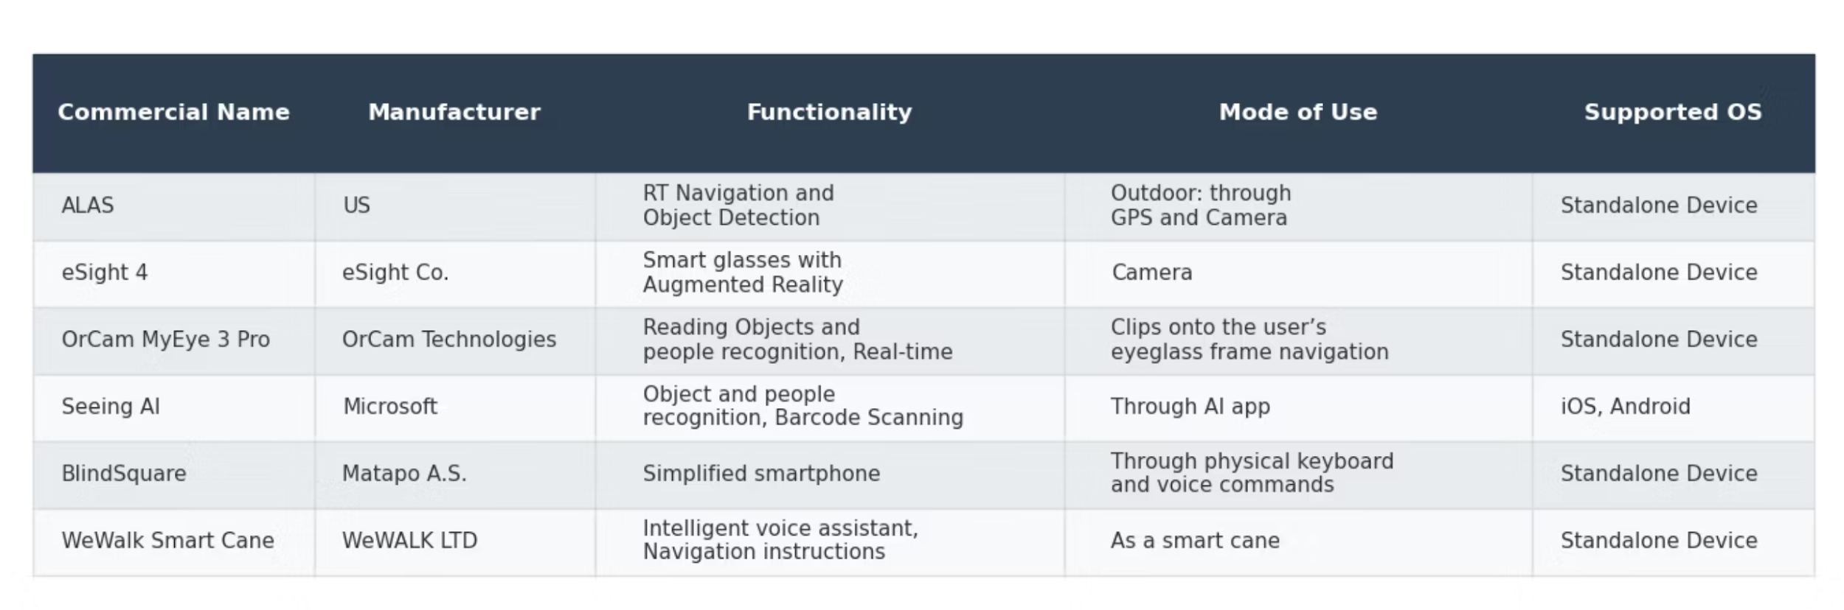
Where ALAS Fits in Assistive Technologies
Existing solutions in the assistive technology landscape for the visually impaired typically fall into three primary categories, each with distinct limitations:
High-cost proprietary wearables: Often expensive and inaccessible, limiting broad adoption.
Smartphone-based, cloud-dependent applications: Reliant on internet connectivity, posing challenges in areas with poor network coverage and raising privacy concerns.
Basic sensor-based aids: Offer limited contextual awareness, struggling with complex environments and dynamic obstacles.
ALAS aims to bridge these gaps by providing an affordable, robust, and privacy-centric alternative.

Slide 5
User-Centered Capabilities
ALAS is designed with a strong focus on enhancing user independence and safety through a suite of core functionalities.
1
Safe & Independent Walking
Enables confident movement in complex outdoor environments.
2
Obstacle Detection
Identifies hazards with basic semantic descriptions, improving environmental understanding.
3
Offline Navigation
Provides reliable pedestrian guidance without reliance on internet connectivity.
4
Hands-Free Audio Guidance
Utilizes Text-to-Speech for intuitive, real-time directional cues and warnings.
5
Voice Commands
Button-activated Speech-to-Text allows seamless control and information requests.
6
Privacy-Preserving
Ensures all data processing occurs locally on the device, safeguarding user privacy.

Slide 6

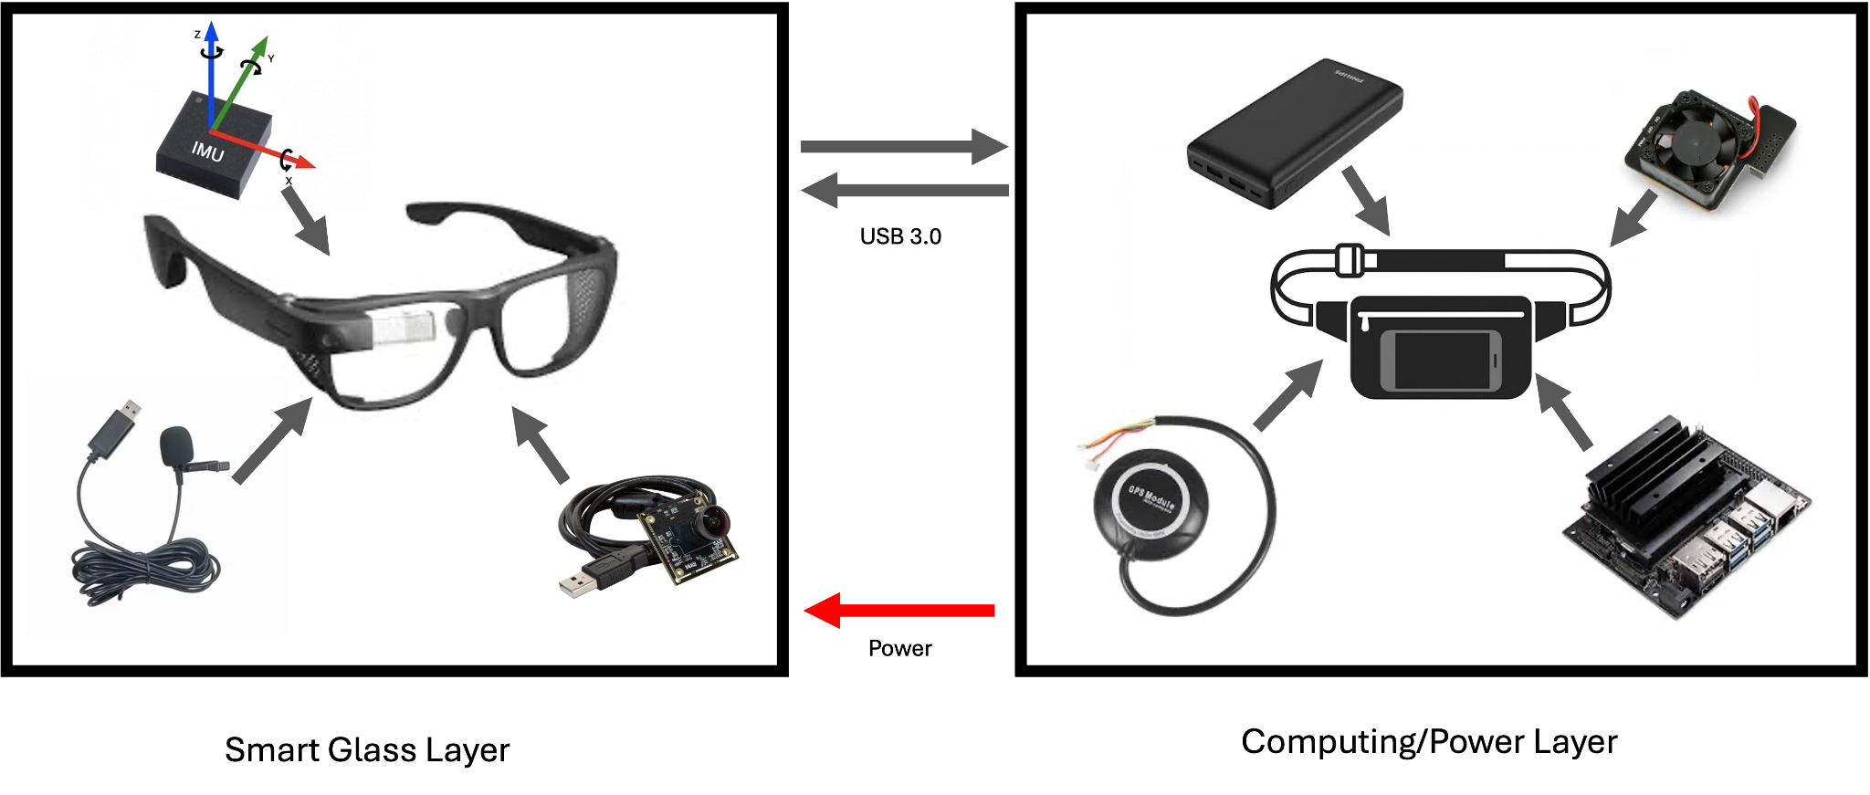
System Architecture Overview
The ALAS system is built upon a robust architecture designed for efficiency, reliability, and modularity.
Smart Glass Layer: Captures scene and user inputs via RGB camera, IMU, microphone/speaker, and a touch button for interaction.
Computing/Power Layer: Runs real-time on-device AI inference on Jetson, performs sensor fusion (camera/IMU/GPS), executes routing/alerts, and supplies power via the battery and PM module.
Modular Software Architecture: Pipeline-based flow (Capture → Preprocess → Perception → Navigation → Feedback) so models and algorithms can be swapped or upgraded easily.

Slide 7
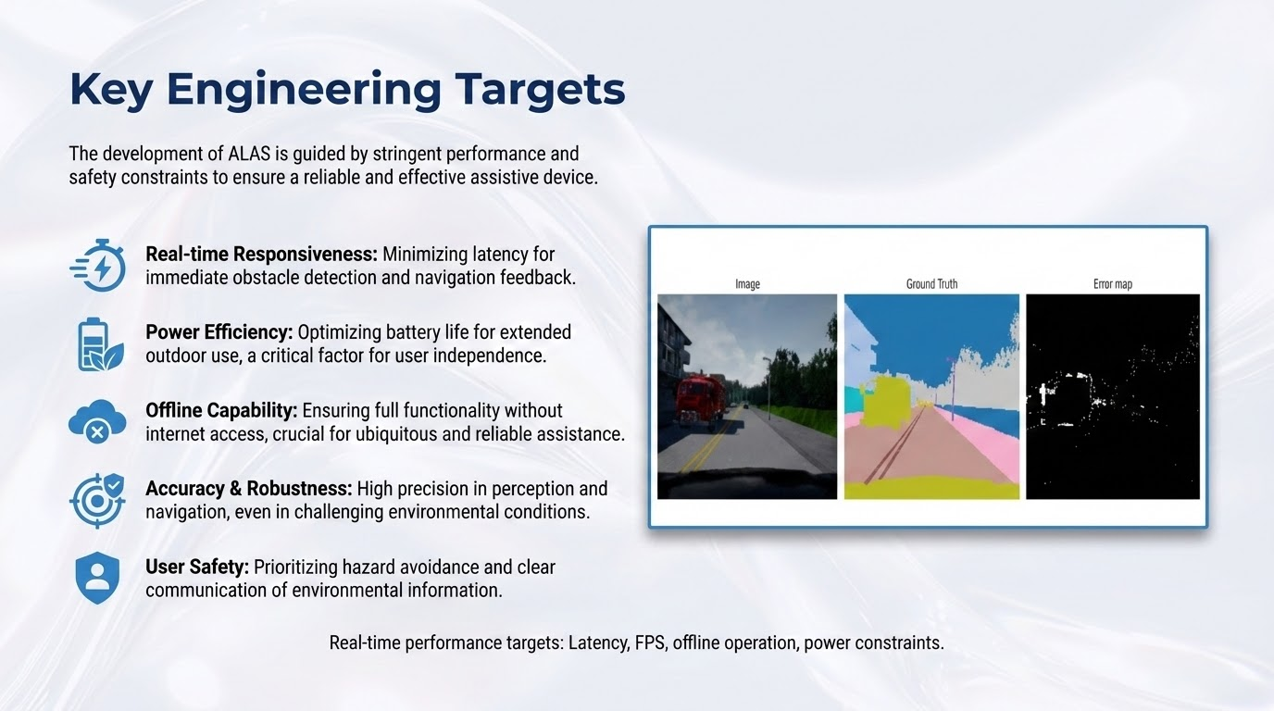

Slide 8




Perception Pipeline
The perception pipeline in ALAS is critical for real-time environmental understanding, enabling effective obstacle awareness and safe navigation.
Image Capture
Preprocessing
High-resolution image acquisition from the integrated camera module.
Image enhancement and noise reduction to optimize input for AI models.
AI-Based Perception
Obstacle & Risk Estimation
Utilizes semantic segmentation and object detection for comprehensive environmental understanding.
Calculates distance to detected objects and assesses potential collision risks.
Edge AI is chosen for low latency, reliability in varying conditions, and enhanced user privacy through on-device processing.

Slide 9








Offline Navigation and Interaction
ALAS provides robust, internet-independent navigation complemented by intuitive user interaction methods.
Path Planning
Voice Commands
On-device A* algorithm computes optimal routes using pre-loaded map data.
User initiates commands via button-activated Speech-to-Text.
Route Deviation Checks
Audio Guidance
Continuous monitoring and re-routing in case of off-path movement.
Text-to-Speech provides real-time turn-by-turn directions and environmental alerts.
This closed-loop system ensures consistent and adaptive navigation assistance.

Slide 10

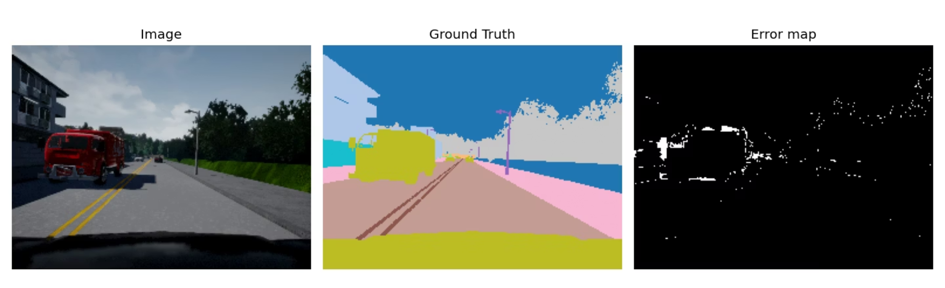
Key Engineering Targets
The development of ALAS is guided by stringent performance and safety constraints to ensure a reliable and effective assistive device.
Real-time Responsiveness: Minimizing latency for immediate obstacle detection and navigation feedback.
Power Efficiency: Optimizing battery life for extended outdoor use, a critical factor for user independence.
Offline Capability: Ensuring full functionality without internet access, crucial for ubiquitous and reliable assistance.
Accuracy & Robustness: High precision in perception and navigation, even in challenging environmental conditions.
User Safety: Prioritizing hazard avoidance and clear communication of environmental information.
Real-time performance targets: Latency, FPS, offline operation, power constraints.

Slide 11

Key Design Decisions
The development process involved critical evaluations and trade-offs between various engineering alternatives to optimize system performance and user experience.
Edge vs. Cloud Processing:
Embedded Platform Selection:
Analysis of on-device computation versus remote server processing for AI tasks.
Evaluation of hardware platforms based on processing power, energy efficiency, and form factor.
Camera Choice:
Selection criteria included field of view, resolution, low-light performance, and integration compatibility.
Decision Topic
Option 1
Option 2
Rationale
AI Processing Location
Cloud Processing
✓ Edge Processing
Lower latency, offline reliability, and stronger privacy guarantees.
Embedded Platform
Raspberry Pi 5
✓ Jetson Nano
Meets real-time AI requirements despite higher cost.
Camera
RGB-D Camera
✓ RGB Camera
Better wearability and cost efficiency.

Slide 12
Key Design Decisions
Perception Model Selection:
Offline vs. Online Navigation:
Assessment of various AI models for semantic segmentation and object detection concerning accuracy and computational demand.
Decision on map data storage and route planning methods to ensure internet independence.
Interaction Design Choices:
Exploration of different modalities for user input and feedback, prioritizing ease of use and accessibility.
Decision Topic
Option 1
Option 2
Rationale
Interaction Trigger
Always-listening STT
✓ Button-activated STT
Lower power consumption and reduced unintended activation.
AI Perception Segmentation
U-Net (Segmentation CNN)
✓ YOLO (Most Likely
U-Net accuracy is high, but real-time performance on embedded hardware is uncertain.
Navigation Strategy
Cloud-based Maps
✓ Offline Maps
Full independence and privacy without internet dependency.

Slide 13
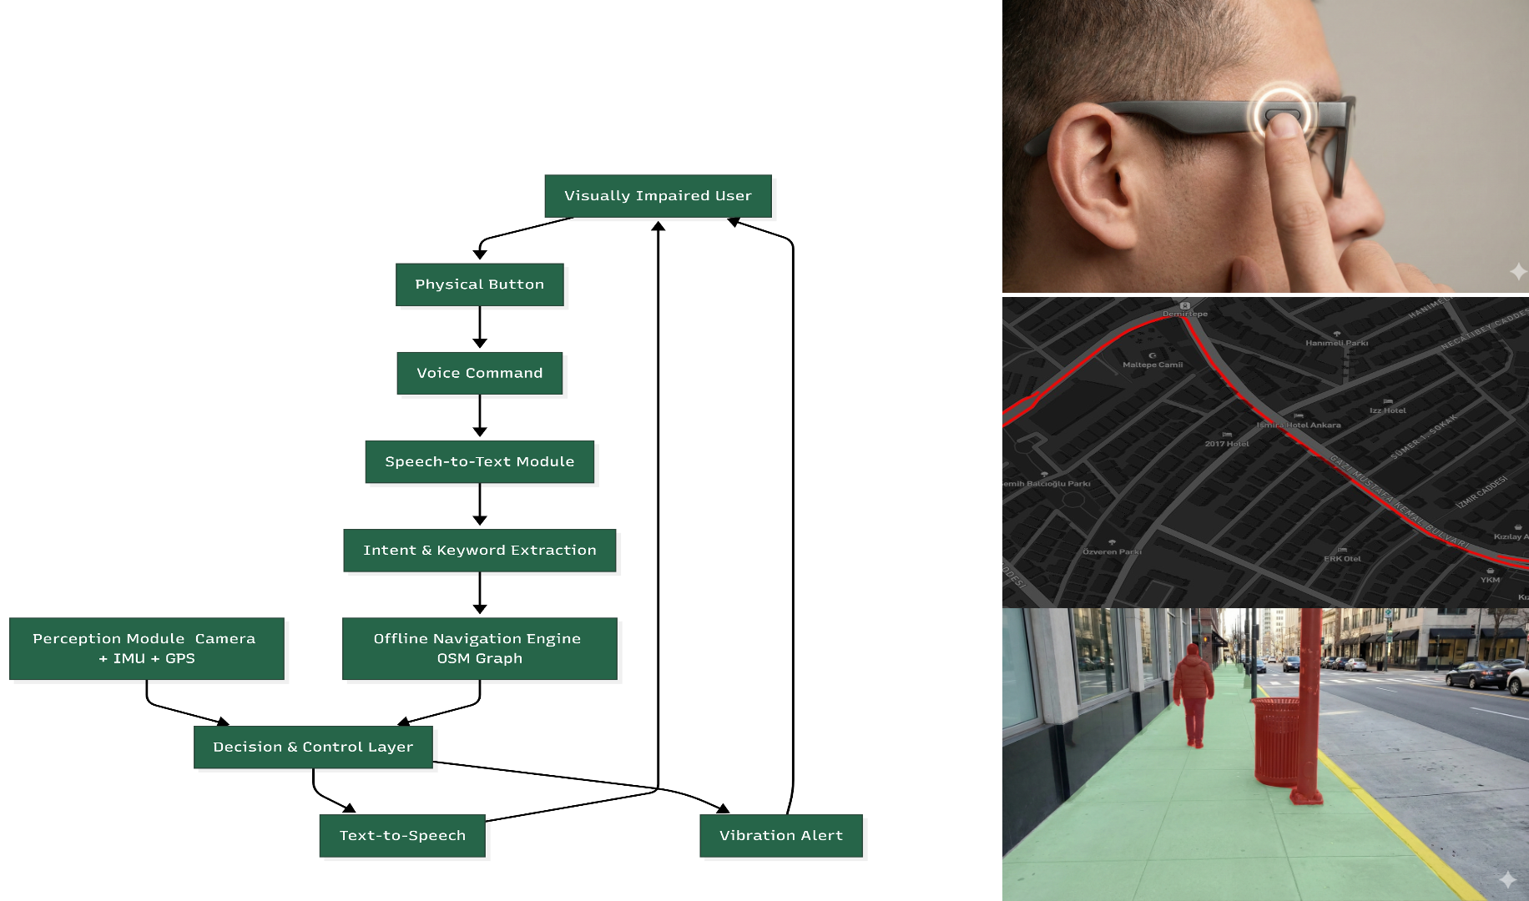
Concept of Operation

Slide 14

Risks & Mitigations
We explicitly model failure modes and design comprehensive fallbacks to keep guidance safe, reliable, and responsive across challenging real-world conditions.
Power / Battery Drop
Sensor Loss / Intermittent (Camera/GPS/IMU)
Risk: Battery sag or low charge can lead to FPS/latency degradation, missed alerts, and unexpected shutdowns.
Risk: Temporary dropouts from essential sensors can result in incorrect obstacle warnings or unstable navigation.
Mitigation:
Mitigation:
Power budgeting with an intelligent low-power mode (reducing resolution/FPS, prioritizing critical alerts).
Continuous health checks and a watchdog system to monitor sensor status.
Battery thresholds with distinct warnings (20% for alert, 10% for critical).
Degraded-mode behavior, switching to navigation-only or alert-only functionality.
Graceful and safe shutdown procedures to prevent data loss or sudden halts.
Automatic re-connection attempts and an "uncertainty" warning to the user.
Audio Channel Failure / High Noise
Map / Route Validity (Offline OSM Region)
Risk: Text-to-Speech (TTS) guidance may not be audible in loud environments like traffic or crowded spaces, causing the user to miss critical information.
Risk: Pre-downloaded OpenStreetMap (OSM) regions may become outdated due to roadworks or new crossings, leading to incorrect routing or delayed rerouting.
Mitigation:
Mitigation:
Adaptive volume control combined with short, standardized audio prompts.
Robust map versioning system with periodic automatic updates.
Repeat critical alerts to ensure comprehension.
Dynamic rerouting initiated upon detecting a mismatch or significant deviation from the map.
Optional haptic vibration feedback for critical warnings to provide an alternative alert mechanism.
Conservative instructions provided to the user when navigation confidence is low.
Physical Robustness (Outdoor Wear)
Privacy & Data Security
Risk: Exposure to outdoor elements, such as vibration, impacts, sweat, or rain, can cause intermittent failures, connector loosening, or device shutdown.
Risk: Wearable systems with camera/audio can raise privacy concerns (unauthorized capture, data leakage, misuse), reducing user trust and adoption.
Mitigation:
Mitigation:
Design incorporating strain relief and securely fastened connectors.
Edge-first, offline processing (no cloud upload or streaming of raw data).
Basic sealing to protect against moisture and environmental ingress.
Privacy-by-design principles, including minimal or no local storage by default.
Rigorous drop and field testing to ensure durability.
Clear user consent mechanisms and visible status indicators for active sensing.
Fail-safe "stop & scan" message on critical fault detection to protect the user.

Slide 15


Title
Conclusion and Future Work
ALAS demonstrates the feasibility of a reliable, offline, and cost-effective assistive navigation system using embedded artificial intelligence.
Improved AI Models
Enhancing perception capabilities for finer environmental detail and object recognition.
Additional Sensors
Integration of lidar or ultrasonic sensors for improved depth perception and varied environmental conditions.
Hybrid Navigation
Developing seamless transitions between indoor and outdoor navigation modes.
Field Testing
Extensive validation with visually impaired users in diverse real-world scenarios.
Miniaturized Hardware
Focus on reducing size and weight for enhanced wearability and aesthetics.

